Slide 1
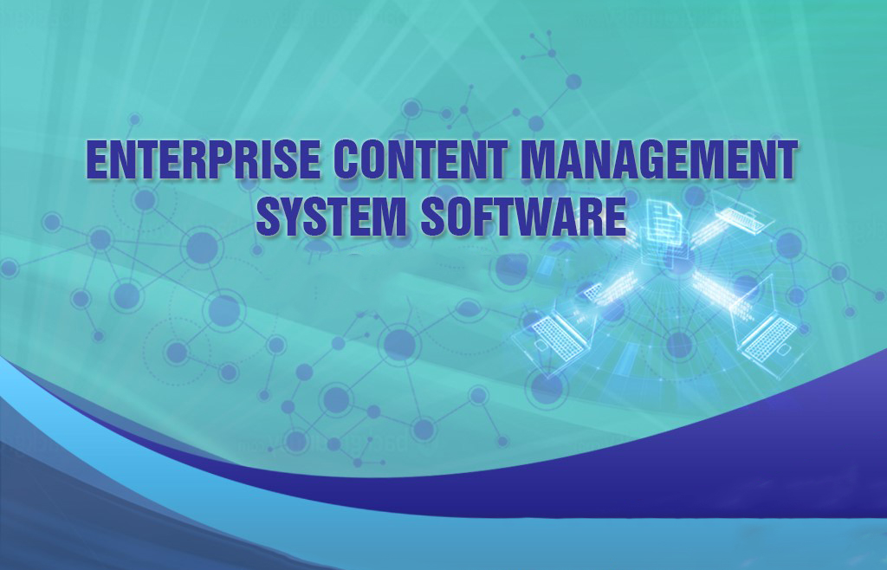

(INHALTIX)

Slide 2
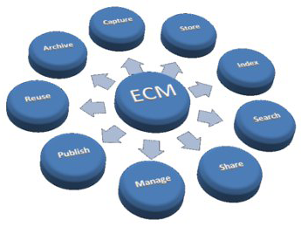
OVERVIEW
Enterprise Content
Management Software System (ECM), powerful ECM platform that is easy to extend, customize and integrate with your existing applications and processes. The platform provides easy mobile access to content, delivers a simple but rich collaboration user experience and helps customers maximize the value of their content. It is the preferred ECM platform for thousands of customers worldwide.

Slide 3

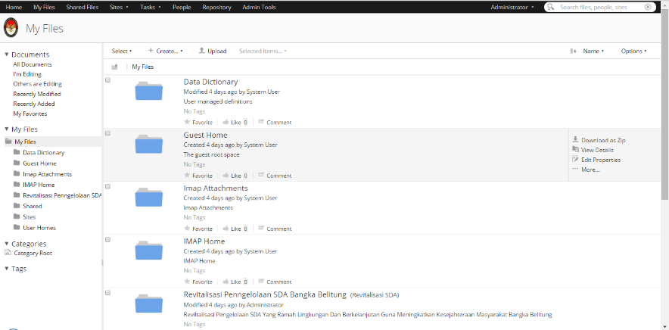
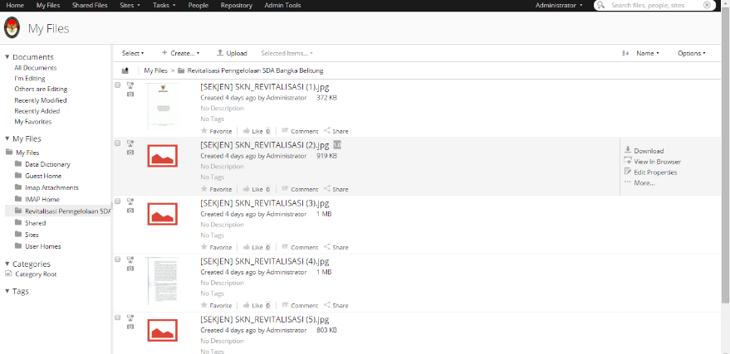
Features
Customizable Page Components.
Transactional and secure across all Services.
Accessible from any environment
Capture boils down to entering content into the system.
Possibility to allow organizations to manage any type of content. Manage is what you do next to it, so it can be found and used by whomever it is intended for.
Storing it means finding it an appropriate home in your infrastructure, be it a formal content management system or other information solution.

Slide 4
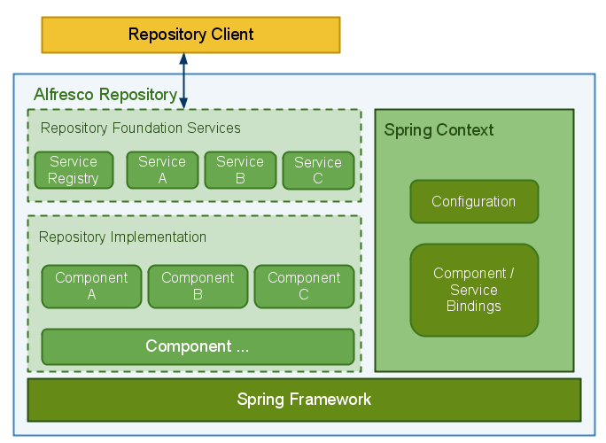
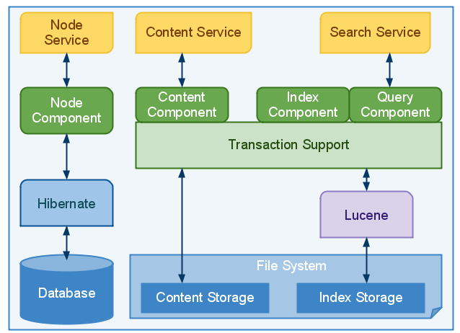
System Architecture
Components & Service APIs - Spring Framework
Enterprise Content Management Software System has made Spring the core foundation of its architecture. Enterprise Content Management Software System components are declaratively configured and bound together using Spring configuration. Aspect-oriented programming features of Spring allows the weaving of infrastructure concerns such as Transactions and Security into components without duplicating functionality.
A Triplet of Key Foundation Services
provided by the following three Foundation Services:
Nodes provide meta-data and structure to content.
Content is the actual information being recorded e.g. a Word document or XML fragment.
Search Service - indexing information and allows the retrieval of meta-data and content via many different lookup options.

Slide 5
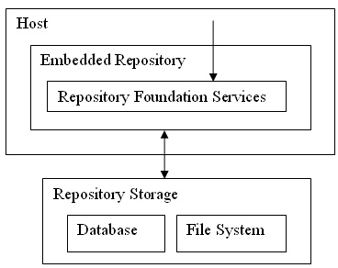
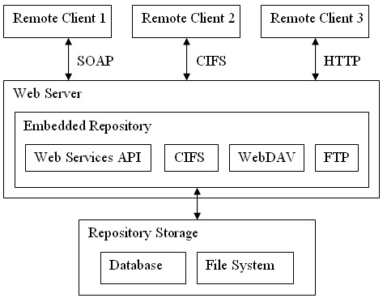
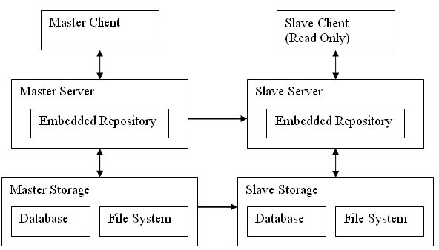
System Architecture
Repository Deployment Options
Embedded Repository
An Embedded Repository is contained directly within a host where the host communicates with the Repository in the same process via the Repository Foundation Services.
Repository Server
A Repository Server is a stand-alone server capable of servicing requests over remote protocols and providing appropriate responses.
Embedded Repository
In this deployment, one Repository Server is designated the Master and another completely separate Repository Server is designated the Slave

